Slide 1
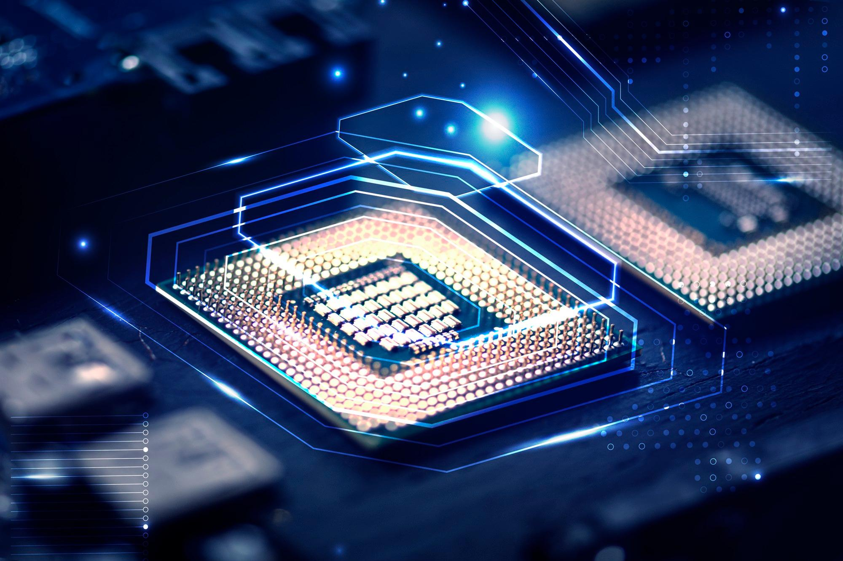
Gaming CPUs & GPUs
Choose the right one for your gaming setup
By Rohit Paul

Slide 2
Basic information regarding CPUs
These days CPU are getting much powerful than ever and scenario centric like :
Process-centric CPU: These CPUs are better suitable for heavy computational
Processes (such as rendering and playing games). Usually Intel CPUs are suitable for this due to high single core Clock count which can be further boosted.
Multi-tasking/workstation oriented CPU: These CPUs are better for handling multiple instances of processes (such as video editing, streaming) because of having increased number of cores and threads. Usually AMD CPUs are better fit for this due to having more cores & threads than other conventional CPUs. One of the best example of this will be Ryzen Threadripper which has 64 cores and 128 threads which can also handle multiple
GPUs.
This Presentation is made with the help of analytics to help you make better choices when buying CPUs for your gaming station.

Slide 3
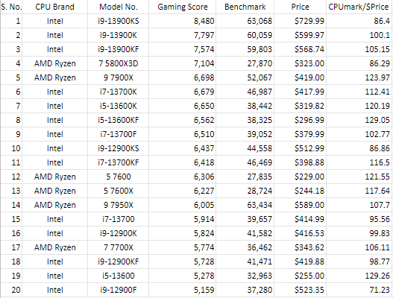
Benchmark, Gaming score and Price of latest CPUs
The Gaming Score depends on how well the CPU performs in gaming.
Benchmarks allow easy comparison between multiple CPUs by scoring their performance on a standardized series of tests, and they are useful in many instances: When buying or building a new PC.
CPUmark/$Price is a score that denotes the CPU performance for every dollar spent.
*The data is gathered from https://www.cpubenchmark.net

Slide 4
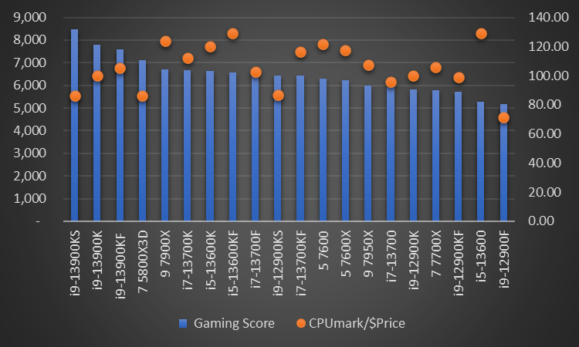
Choosing the right CPU for your setup
With the help of this chart we can understand that:
We should focus on the CPUs which have high gaming score and a high CPUmark/$Price to get the best value for money.
The i9-13900KS has the highest gaming score but has a low CPUmark/$Price. So, it won’t be a good choice if you want to be efficient with your money.
On the other hand, i5-13600 has the highest CPUmark/$Price but lower gaming score. So, it won’t be that great for gaming.
After studying the chart we can get an insight of some good CPUs like: Ryzen 9 7900X, i5-13600KF, Ryzen 5 7600 and i9-13900KF.
*The latest prices are gathered from https://www.amazon.com

Slide 5
Basic information regarding GPUs
Discrete GPUs have their own microprocessor chip and set of VRAMs(Video memory) which independently processes and render graphics mostly without taking help of CPU and RAM.
So, when it comes for Gaming PC, GPUs are must have. Due to providing a massive boost in performance.
But there are some GPUs which are different from others. Most GPUs use faster VRAM to render graphics quickly with super low latency & provide a smoother experience. On the other hand, there are some GPUs which have Better/powerful Microprocessor chip but slower VRAM.These GPUs are used in extreme platforms for crypto mining, streaming, server-type workstations.

Slide 6
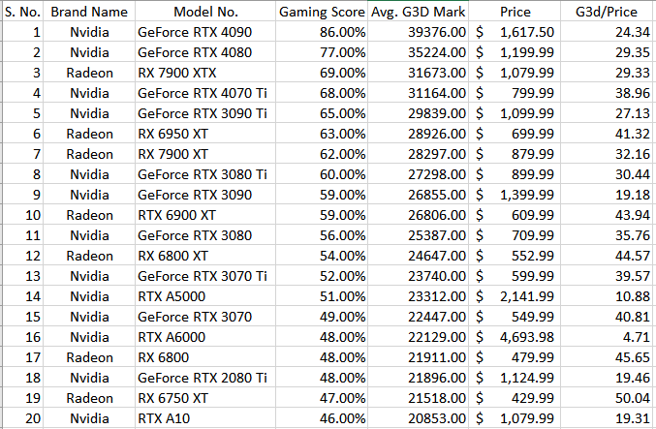
G3D-mark, Gaming score and Price of latest GPUs
The G3DMark represents a summary of the test suite. These mark values only appear if all the tests in a particular suite have been run.
G3D/$Price shows the value for money, in terms of the G3DMark per dollar.
Gaming Score denotes the performance with respect to the highest performance a GPU can deliver under ideal condition.
*The data is taken from https://www.videocardbenchmark.net

Slide 7
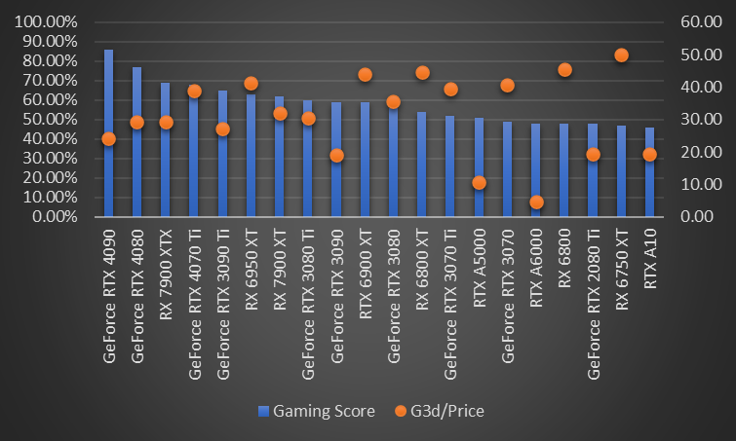
Choosing the right GPU for your setup
With the help of this chart we can understand that:
We should focus on GPUs that have high gaming score along with high G3D/$price which ensures that you can get the best GPU for your money.
We can see that Geforce RTX 4090 has the highest gaming score but a kind of low G3D/$price. So, it won’t be an efficient choice.
Also, we can see that RX 6750XT has the highest G3D/$price but a respectively low gaming score.
After studying the chart we can get an insight of some good GPUs like: GeForce RTX 4070 Ti, RX 6950 XT, GeForce RTX 3070 Ti, RX 6800 XT.
*The latest prices are gathered from https://www.amazon.com

Slide 8
Conclusion
In conclusion, we can say that analytics gives us insights and helps to make better choices.
Although CPUs and GPUs are main components for pc building, there are also other necessary peripherals such as: motherboard, RAM, power supply, coolers, fans, monitor, keyboard and mouse.
If we efficiently spend our money, we can build a well-balanced gaming pc. Maybe with some cool RGB and a curved OLED. Which is better in my opinion than going all out on CPU & GPU and then build your own DIY case with cardboards.
Most important part to throw attention is that Intel CPUs tend to go well with Nvidia GPUs and Ryzen with Radeon. So, make sure to choose the right combo.

Slide 9
Thank You

